Slide 1
National Cipher Challenge
A beginner’s guide to codes and ciphers
Part 1, the Caesar shift cipher and pattern detection

Slide 2
The most famous cryptographer in history?

Slide 3
The most famous cryptographer in history?

Slide 4
The most famous cryptographer in history?
Julius Caesar invented (or at least used)
The Caesar shift cipher

Slide 5
Notes:
Distribute the cipher wheel handout printed on thin card, together with scissors and paper fasteners. Get the class to cut them out and assemble them as above.

Slide 6
Word shape really helps a lot!
WKH HDVLHVW PHWKRG RI HQFLSKHULQJ D WHAW PHVVDJH LV WR UHSODFH HDFK FKDUDFWHU EB DQRWKHU XVLQJ D ILAHG UXOH, VR IRU HADPSOH HYHUB OHWWHU D PDB EH UHSODFHG EB G, DQG HYHUB OHWWHU E EB WKH OHWWHU H DQG VR RQ.

Slide 7
The most common 3 letter word?
WKH HDVLHVW PHWKRG RI HQFLSKHULQJ D WHAW PHVVDJH LV WR UHSODFH HDFK FKDUDFWHU EB DQRWKHU XVLQJ D ILAHG UXOH, VR IRU HADPSOH HYHUB OHWWHU D PDB EH UHSODFHG EB G, DQG HYHUB OHWWHU E EB WKH OHWWHU H DQG VR RQ.
So maybe W -> t, K -> h and H -> e

Slide 8
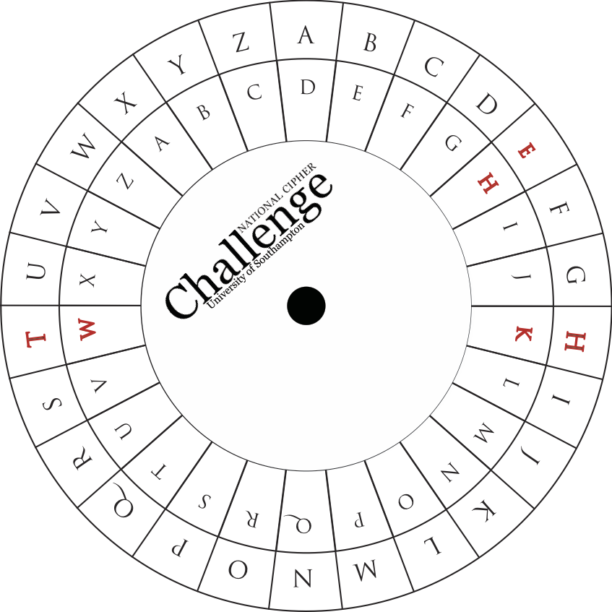
Lining up the cipher wheel so that T matches with W we see H matching with K and E with H. A matches to D so we guess that the cipher we need is a shift by 3.
(We need to be careful to match the plain text on the outer ring with the ciphertext on the inner ring.)
You can now use the cipher wheel to decrypt the rest of the message.

Slide 9
In which case
the eDVLeVt PethRG RI eQFLSHeULQJ D teAt PeVVDJe LV tR UeSODFe eDFe FhDUDFteU EB DQRtheU XVLQJ D ILAeG UXOe, VR IRU eADPSOe eYeUB OetteU D PDB Ee UeSODFeG EB G, DQG eYeUB OetteU E EB the OetteU e DQG VR RQ.

Slide 10
The easiest method of enciphering a text message is to replace each character by another using a fixed rule, so for example every letter a may be replaced by d, and every letter b by the letter e and so on.

